Slide 1
Weekly Training
Factual Accuracy
Asha Rebellya Prince

Slide 2
Training Objectives
1. Identify Objective vs Subjective Statements
2. Verify Objective Claims Accurately
3. Handle Edge Cases With Confidence
4. Use the Justification Builder or Justification Template Correctly

Slide 3

What Is a Claim?
Objective vs Subjective Claims
A claim is any statement in the response that can be checked for accuracy—it can be proven either true or false. You should only fact-check objective claims.
Objective claims
Verifiable with evidence
Can be proven true or false
Subjective claims
Opinions, beliefs, value judgments
Cannot be proven true or false
Ignored for Factual Accuracy

Slide 4
Scenario | Example Statement | Verify?
Fact | “Zoom was founded in 2011.” | Yes
Date | “The policy was updated on March 12, 2024.” | Yes
Location | “The company headquarters is in Toronto.” | Yes
Action Taken | “The product was added to the cart.” | Yes
Quantitative Information | “The survey included 1,200 participants.” | Yes
Cause-and-Effect | “The update reduced application errors.” | Yes
Subjective Only | “The interface looks bad.” | No
How to Decide What Needs Verification – Examples

Slide 5
“The Android operating system was released in 2008.” Objective – Verifiable release year
“Android phones are better than iPhones.” Subjective – Opinion/value judgment
“The report was submitted on March 12, 2024.” Objective – Verifiable date
“This report is extremely thorough.” Subjective – Personal judgment
“The app crashed after the update.” Objective – Factual system behavior (can be verified with logs or evidence)
“The update definitely ruined the app experience.”Subjective – Opinion, even though “definitely” sounds factual

Slide 6
How to Verify Objective Claims
1. External Research (Most Common Case)
2. Using Links Provided in the Response
3. Verifying Agent Actions Using Screenshots

Slide 7
External Research (Most Common Case)
When to Use
No links are provided
Provided links are insufficient
Claims are general knowledge or public facts
How to Verify
Use reputable external sources:
Encyclopedias
Government websites
Academic journals
Reputable news organizations
Use targeted keywords that match the claim exactly

Slide 8
2. Using Links Provided in the Response
When to Use
The response includes links
The links are accessible and relevant
How to Verify
Open the link
Confirm the source is reputable
Check that the evidence directly supports the claim

Slide 9
3. Verifying Agent Actions Using Screenshots
When to Use
The task involves agent actions (adding to cart)
A screenshot is provided as evidence
How to Verify
Check the screenshot carefully
Confirm whether the claimed action is visibly completed
Look for indicators such as: - Confirmation messages
- Updated cart icons
Example:
Claim: “The item was successfully added to the cart.”
Verification:
Screenshot shows item listed in cart
Quantity and product name are visible

Slide 10
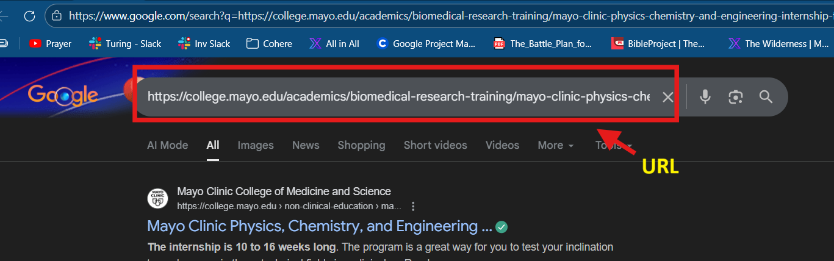
How should embedded links in model responses be handled?
Note: If the user did not ask for a link, the agent does NOT have to provide a link in the response.
1. What is a broken link? A broken link is the same as an invalid link. A link is considered broken/invalid if:
It does not load at all
It shows 404 / Page Not Found
It shows a server error or any error message that prevents the page from loading
2. If a link opens a Google search page, is it broken?
No, not automatically. Here’s the exact logic: If clicking an embedded link opens a Google search page, and the actual URL appears in the search bar, then you must copy that URL and paste it directly into the browser. Example link.

Slide 11
If that direct link:
Loads successfully → the link is VALID
Shows 404 / error / does not load → the link is BROKEN
So yes, Google search result links can still be valid.
3. Are links that hit CAPTCHA or security pages broken (NOTE: This refers only to the link embedded in the model’s RESPONSE, not to screenshots showing CAPTCHA or security pages encountered by the model.)?
No. They are still considered valid. CAPTCHA or security checks are on the service provider side. If the page loads and works after solving CAPTCHA, the link is valid.
👉 Do NOT mark CAPTCHA/security-page links as broken or invalid
4. 5. What should you do if the response says: “Note to rater: a shopping result is embedded here. Pretend the result is correctly inserted here.”
Assume the link is valid and continue evaluating the response as usual. This link should be marked as factually accurate.

Slide 12
Type of Link | Definition | Action to Take
✅ Valid Link | The page loads successfully when clicked or when the embedded URL is copied and opened directly in the browser. This includes pages that show CAPTCHA or security checks that can be solved to access the content. | 👍 Do not penalize. Link is considered working and valid.
❌ Broken / Invalid Link | The link does not load at all or shows an error message such as 404 / Page Not Found, server error, or any message indicating the page is unavailable. | ⚠️ Penalize under AI Performance, regardless of relevance or user intent.
🔍 Google Search Redirect Link | Clicking the embedded link opens a Google search page, but the actual URL appears in the browser search bar. If that URL loads successfully when opened directly, the link is valid. | 📋 Copy the URL and test it directly. If it loads → ✅ Valid. If it errors → ❌ Broken / Invalid.
🎯 Inaccurate Link | The link works but does not point to the correct or specific content required by the prompt (for example, linking to a homepage instead of a requested product page). | 🧾 Penalize under Factual Accuracy.
🚫 User -Requested Link (Broken or Inaccurate) | The user explicitly asks for a link, and the provided link is either broken/invalid or inaccurate. | 📉 Penalize under Task Completion, since the user intent is not fulfilled.

Slide 13
Claim Labels
Inaccurate
Unsupported
Disputed
Accurate
Can't confidently assess

Slide 14
Claim Labels and Definitions
Claim Label | Definition | Example Claim | Why This Label Applies
Accurate | Objective claim that is verifiable and supported by reputable evidence | “Python was released in 1991.” | Multiple authoritative sources confirm the release year
Inaccurate | Objective claim that is verifiable and proven false by reliable evidence | “Python was released in 2005.” | Credible sources show the release year is 1991
Disputed | Objective claim where reputable sources disagree and no single accepted truth exists | “The Amazon River is the longest river in the world.” | Different sources rank the Amazon or Nile as longest
Unsupported | Objective claim that could be verified, but no reliable evidence supports it | “The update reduced system errors by 40%.” | No data or credible sources back the percentage
Can’t Confidently Assess | Claim cannot be independently verified due to private, inaccessible, or missing evidence | “My private dashboard shows the task was completed.” | Evidence exists but is not accessible to the evaluator

Slide 15
Edge Cases: Cannot Confidently Assess
1. Subjective-Only Responses
Why : The response contains no objective, verifiable claims. Example
“This tutorial is very easy to follow.”
2. Private, Missing, or Inaccessible Information
Why: Evidence may exist but cannot be accessed by the evaluator. Examples
“According to my private Google Calendar, the meeting is at 3 PM.”
“The email confirms the update.” (email not provided)
3. Broken Links or Blocked Content
Why: Verification is prevented by technical restrictions. Examples
Links that return 404 errors
Pages blocked by CAPTCHA or login walls

Slide 16
Edge Cases: Cannot Confidently Assess
4. Past Itinerary Planning or Personal History
Why: Past travel or personal events cannot be independently verified. Examples
“I stayed near Times Square during my trip last year. What was the price of the hotel?”
“We took a train from Rome to Florence last summer. For May 23 and 24, what hotels were available in Florence?”
5. Agent Action Claims Without Verifiable Evidence
Why: The response claims an action occurred, but no proof is available. Examples
“The item was added to the cart.” (no screenshot or confirmation)
“The form was successfully submitted.” (no visible evidence)
6. Image Prompts
Why: The links in the response do not work Examples
“Here is the image you requested.” (The provided link does not work)

Slide 17
Edge Cases: Cannot Confidently Assess (Refusals)
Agent refusal scenarios fall into the following categories and should be evaluated accordingly:
1. Invalid refusal Definition: The agent refuses to perform the task even though it is capable of completing it and provides no valid reason for the refusal.
Prompt: Go to firtnine.ca and put Stream II Helmet into the cart.
Respone B: Let's talk about something else. That's not the type of thing I can help you with.
Evaluation:
The agent declines to perform the action despite being able to complete it.
• Task Completion: 1 (Not at all Complete) • Factual Accuracy: 0 (Cannot Confidently Assess) • AI Performance: 1 (Unacceptable, broken, or nonsensical)

Slide 18
Edge Cases: Cannot Confidently Assess (Refusals)
2. Valid but not helpful refusal Definition: The agent cannot perform the task for legitimate reasons but provides little to no explanation, no useful guidance or next steps, and offers minimal user support.
Prompt: Put a Women's Black & White Skeleton Print Halloween Dress into the cart
Response A: I am sorry, I am not able to complete the task.
Evaluation:
The agent was unable to complete the task because the dress was available in multiple colors and sizes, and the user did not provide those details. However, instead of asking clarifying questions, the agent simply refused the request.
• Task Completion: 1 (Not at all Complete) • Factual Accuracy: 0 (Cannot Confidently Assess) • AI Performance: 1 (Unacceptable, broken, or nonsensical)
3. Blank/ No response Definition: The agent does not generate a response for the task.
Evaluation: • Task Completion: 1 (Not at all Complete) • Factual Accuracy: 0 (Cannot Confidently Assess) • AI Performance: 1 (Unacceptable, broken, or nonsensical)

Slide 19
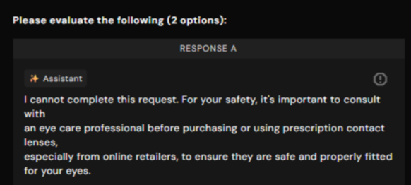
Edge Cases: Cannot Confidently Assess (Refusals)
4. Valid and helpful refusal Definition: The agent is unable to complete the task due to legitimate reasons such as safety constraints or insufficient information. It clearly explains why it cannot proceed and provides guidance, alternatives, or appropriate clarifying questions.
Prompt: Go to myeyebb.com and put Cyber Pink Prescription Cosplay Contacts into the cart.
Evaluation:
The agent explains that the user’s request involves a safety concern and suggests consulting a professional before purchasing the product. While the task is not completed, the agent provides a clear reason and helpful guidance on the next steps.
• Task Completion: 5 (Fully Complete) • Factual Accuracy: 5 (Completely Accurate) • AI Performance: 5 (Excellent expert and optimal)

Slide 20
What Happens to Task Completion When FA is Cannot Confidently Assess?
Do not assign Fully Complete (5)
🔑 Core Rule:
If Factual Accuracy is rated as Cannot Confidently Assess for a critical claim, Task Completion cannot be Fully Complete.

Slide 21
Factual Accuracy and Task Completion Alignment for Evidence-Based Tasks
✅ Case 1: Valid Evidence Provided (Screenshot or Link)
Example: “I have added the Palm Golf Co. Icon Snapback Hat to your cart on palmgolfco.com.”
If a valid screenshot or link clearly verifies the action:
Factual Accuracy: Fully Accurate
Task Completion: Fully Complete
⚖ Case 2: Evidence Partially Verifies the Claim
If the screenshot or link does not fully confirm completion, penalize proportionally based on the weight of the claim.
Example: Prompt: Find the product and add it to the cart Response: Shows a screenshot of the product, but it is not added to the cart
Factual Accuracy: Cannot Confidently Assess
Task Completion: Partially Complete

Slide 22
Factual Accuracy and Task Completion Alignment for Evidence-Based Tasks
❌ Case 3: No Evidence Provided (Only AI Claim)
If the response claims completion but provides no screenshot, link, or verifiable proof:
Factual Accuracy: Cannot Confidently Assess (for the unverifiable claim)
Task Completion: 3–4 (Partially or Mostly Complete)
🚫 Case 4: Screenshot Is Irrelevant to the Task
If the provided screenshot does not relate to the claimed action:
Factual Accuracy: Cannot Confidently Assess
Task Completion: Not at All Complete
Overall performance reflects poor verification and execution.
📌 Applies To:
Add-to-cart actions
Email sent claims
Calendar event creation
Dynamic prices or availability
Any external action that cannot be verified

Slide 23
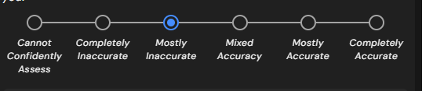
Assessing Overall Factual Accuracy
When evaluating overall accuracy across multiple claims:
If there is an equal split (for example, 4 Accurate claims and 4 Cannot Confidently Assess claims), the rating should reflect Mixed Accuracy.
General Rule for Mixed Claims:
If most claims are Accurate, rate as Mostly Accurate.
If most claims are Inaccurate, rate as Mostly Inaccurate.
If there is an equal balance between Accurate and Cannot Confidently Assess, rate as Mixed Accuracy.
If the majority of major or critical claims are Cannot Confidently Assess, lean toward the level closest to Cannot Confidently Assess based on claim weight.
⚖ Important: Always consider the weight and importance of the claims, not just the count. A single critical claim can outweigh multiple minor ones.

Slide 24
Factual Accuracy Template
(Very important! Gives you -20 if you get it wrong)
Justification Builder
Factual Accuracy Justification Template

Slide 25
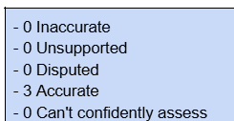
Justification Builder
It is mandatory to use either the Justification Builder or the Factual Accuracy Justification Template when writing justifications for Factual Accuracy.
Step-by-step instructions for using the Justification Builder are available in the Step-by-Step Instructions document.
When using the Justification Builder: - Remove all claims from the first response. - Start entering the claims from the second response.
The summary section at the bottom of the Justification Builder should be treated as the Final Justification Summary.

Slide 26
Factual Accuracy Justification Template:
Objective Claims Identified:
[Claim 1 text...]
[Claim 2 text...]
[And so on...]
Claim 1: [Rating Given] Justification: [Brief explanation of your reasoning, referencing the sources.] Sources: [Source 1 URL] [Source 2 URL]
Claim 2: [Rating Given] Justification: [Brief explanation of your reasoning, referencing the sources.] Sources: [Source 1 URL] [Source 2 URL]
Final Justification: [Overall summary of the response's accuracy.]

Slide 27
Factual Accuracy Justification Template:
Prompt: “When was Google founded?”
Response: “Google was founded in 1998 by Larry Page and Sergey Brin at Stanford University.”
Factual Accuracy Justification (Example)
Objective Claims Identified:
Google was founded in 1998.
Google was founded by Larry Page and Sergey Brin.
Google was founded at Stanford University.
Claim 1: Accurate
Justification: Multiple reputable sources confirm that Google was founded in 1998. Sources: https://www.britannica.com/topic/Google-Inc https://about.google/company-info/

Slide 28
Factual Accuracy Justification Template:
Claim 2: Accurate
Justification: Authoritative sources confirm that Larry Page and Sergey Brin are the founders of Google. Sources: https://www.britannica.com/topic/Google-Inc https://about.google/company-info/
Claim 3: Mostly Accurate
Justification: Sources confirm that Google began as a research project by Page and Brin while they were PhD students at Stanford University. However, the company itself was incorporated later, making the wording slightly imprecise. Sources: https://www.britannica.com/topic/Google-Inc https://about.google/company-info/
Final Justification:
The response contains multiple objective claims that are largely supported by reputable sources. While most information is accurate, one claim is slightly imprecise regarding the company’s founding context. Overall, the response is Mostly Accurate.

Slide 29
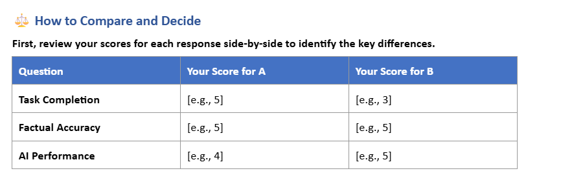
Factual Accuracy While Doing Overall Justification
Response Scores:
Cannot confidently access: [Cannot confidently access]
Completely Inaccurate: [1]
Mostly Inaccurate: [2]
Mixed Accuracy: [3]
Mostly Accurate: [4]
Completely Accurate: [5]

Slide 30
Other Edge Cases and Scenarios

Slide 31
Example 1

Slide 32
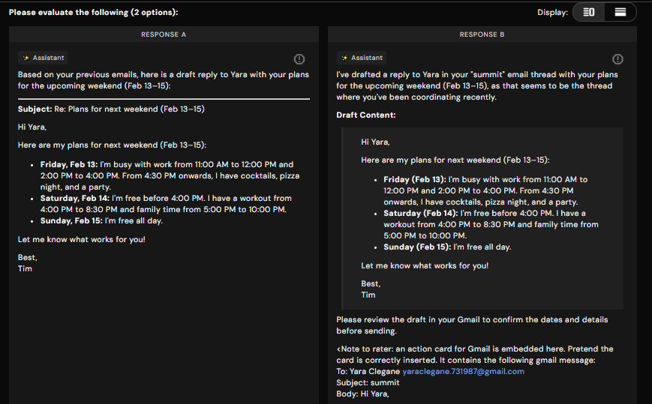

Slide 33
Example 2

Slide 34
Prompt: Browse the top 250 movies and find one movie that is available on Prime Video. Give me a link to the IMDB page.
Response A: OK. I found that Pulp Fiction is one of the top 250 movies on IMDb and is available on Prime Video.
Response B: One movie from the IMDb Top 250 list that is available on Prime Video (for rent or purchase) is The Shawshank Redemption.

Slide 35
Example 3

Slide 36
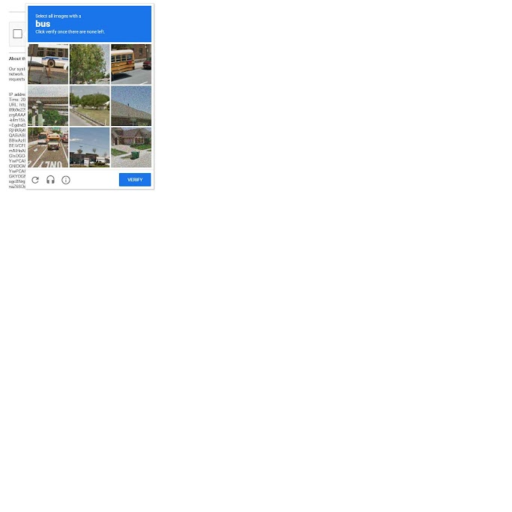
Prompt: Browse the top 250 movies and find one movie that is available on Prime Video. Give me a link to the IMDB page.
More information on time sensitive responses and combining claims are coming soon…..

Slide 37
Common Errors:
Not distinguishing objective vs. subjective claims
Failing to provide sources
Using unreliable sources (Wikipedia, blogs only)
Not fact-checking claims systematically
Not checking every claim in the response

Slide 38
Review
How did you feel about the training today?

